Slide 1
Natural language processing

Slide 2
Tokenization

Slide 3
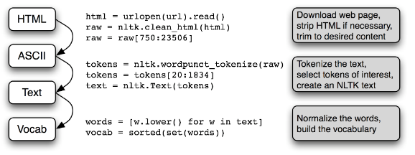
NLP preprocessing pipeline

Slide 4
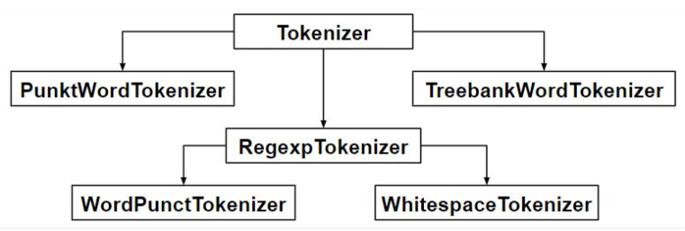
Tokenization
It is the process of tokenization or splitting a string, text into a list of tokens
Word is a token in a sentence, sentence is a token in a paragraph etc.
Sentence tokenization/Word tokenization/regular expression tokenization

Slide 5
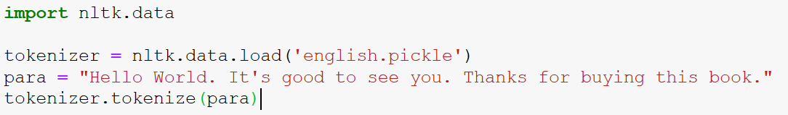
Sentence tokenization
Sent_tokenize uses an instance of PunktSentenceTokenizer from the nltk.tokenize.punkt module
This instance has already been trained and is good for many European languages
S it knows what punctuation and characters mark the end of a sentence and the begning of a new sentence
The instance used in sent_tokenize() is actually loaded on demand from a pickle file
So if you are going to tokenize lot of sentences its more efficient to load the PunktSentenceTokenizer class once and call its tokenize method

Slide 6
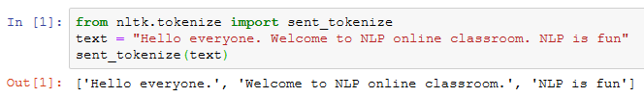
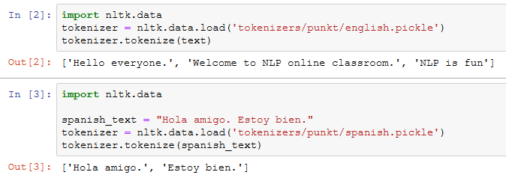
Contd..
Sentence tokenize also known as sentence boundary detection or sentence segmentation
Many NLP tools including Open NLP, NLTK, TextBlob, MBSP stc
NLTK sent_tokenize is one of instances of PunktSentenceTokenizer from the nltk.tokenize.punkt module
Tokenize Punkt module has many pre-trained tokenize module for many European languages
nltk_data/tokenizers/punkt/README file contains the list

Slide 7
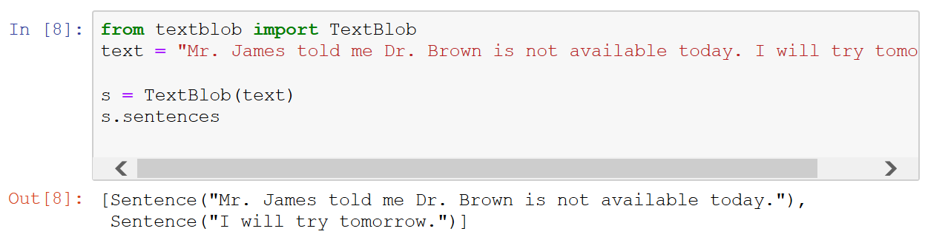
Contd..

Slide 8
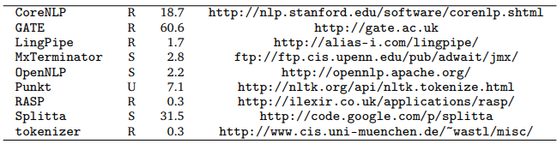
Sentence boundary detection
Several ways – nltk PunktSentenceTokenizer
It is an unsupervised trainable model
Trained on unlabeled data
Text that is not split into sentences
Training a Punkt sentence tokenizer
Build corpus to train our tokenizer
Training
Test
Adding more abbreviations

Slide 9
Stemming & Lemmatization

Slide 10
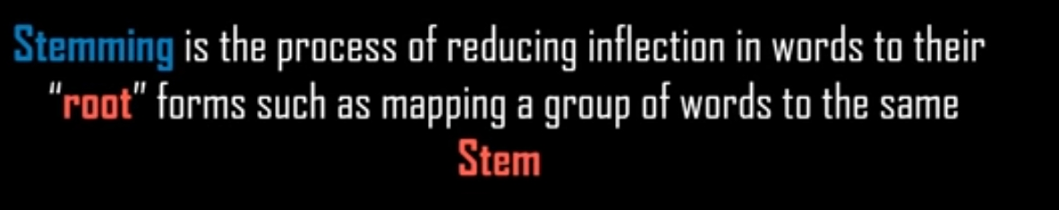
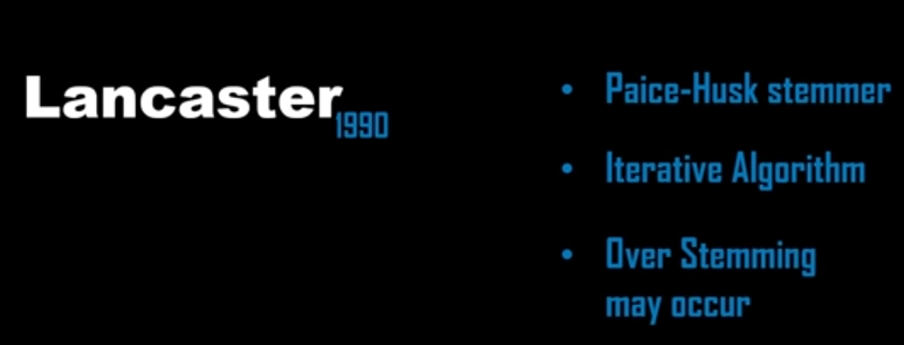
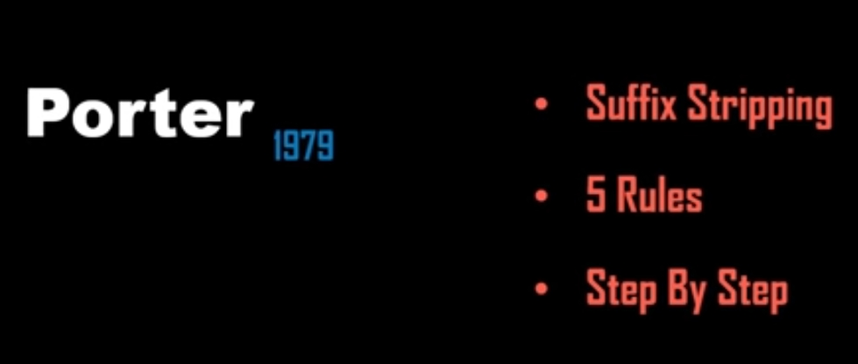
Stemmer

Slide 11
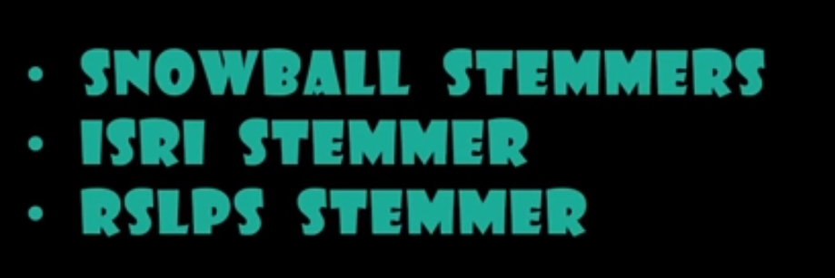
Other stemmers

Slide 12
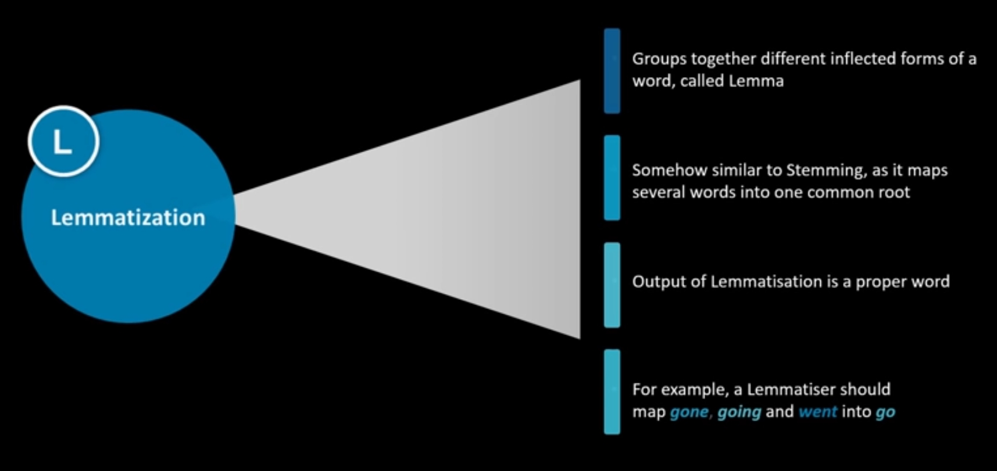
Lemmatization

Slide 13
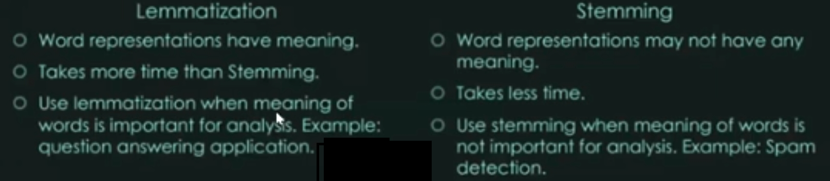
Lemmatization vs Stemming

Slide 14
Text similarity

Slide 15
Distance measurement in text mining
Edit distance based
Hamming, Levenshtein, Jaro-Winkler
Token based
Jaccard index, Sorensen dice
Sequence based algorithm
Ratcliff-Obershelp similarity

Slide 16
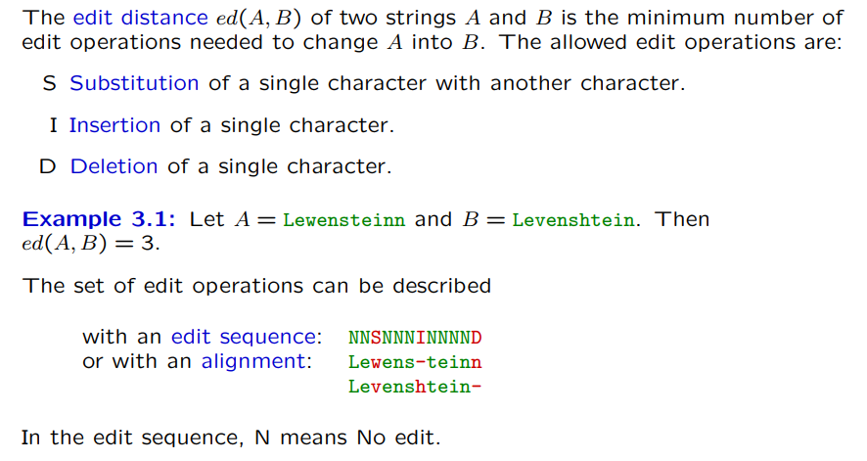
Edit distance

Slide 17
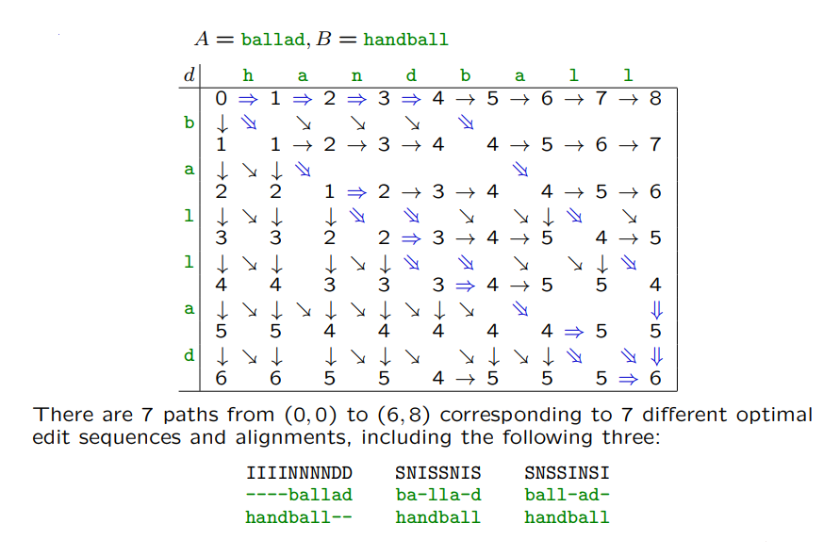
Example

Slide 18
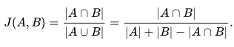
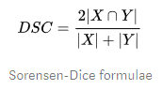
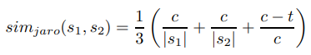
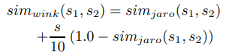
Contd..
Jaccard index
Sorensen-Dice
Jaro
C = no of common characters within half the length, t = no of transposition
Winkler

Slide 19
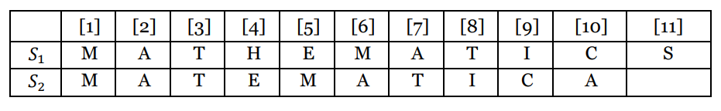
Exercises

Slide 20
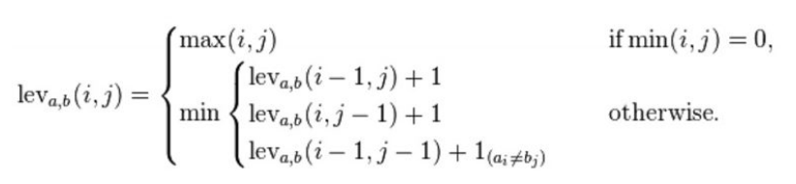
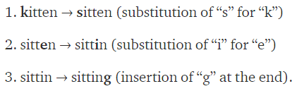
Levenshtein distance
It is the minimum number of single character edits (insertions, deletions or substitions) required to change one word to another
Consider the levenshtein distance between the string kitten and sitting

Slide 21
Text segmentation

Slide 22
Discourse segmentation
Discourse analysis investigates how text are organized and realize their underlying structure
The structure which spans a few sentences is called a discourse segment
Some popular approaches are
TextTiling
Term repetition
Metrics of cohesion
Scoring
Why it is difficult
Not all paragraph boundaries reflect topic shifts
Paragraph conventions genre dependent
Sections often too large

Slide 23
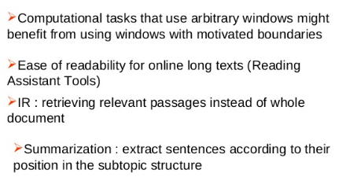
Why segmenting a text into multi paragraph unit

Slide 24
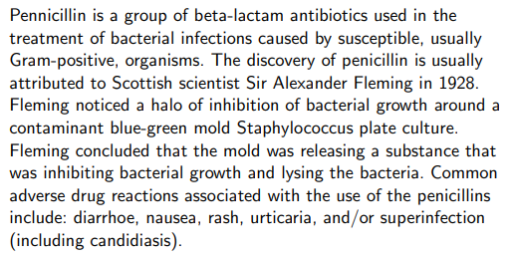
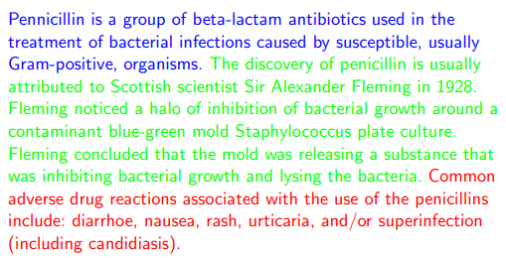
Example
Applications
Text summarization
Information retrieval
Hypertext display

Slide 25
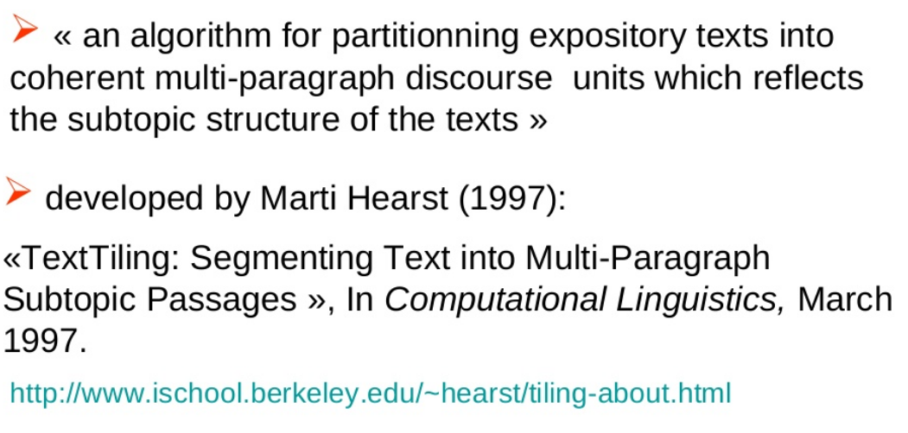
TextTiling algorithm

Slide 26
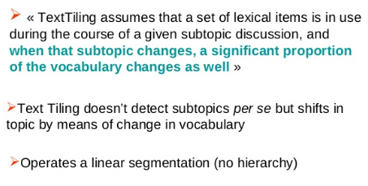
What is the hypothesis behind texttiling

Slide 27
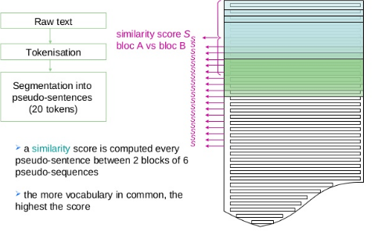
Detection of topic shifts

Slide 28
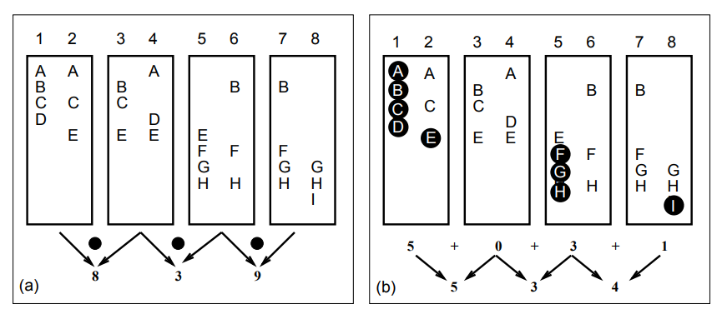
Computing lexical scores at gaps between sentences
A Blocks – dot product of vector of word count between left and right block
B vocabulary introduction – number of words that occur for the first time within the interval centered at the sentence gap

Slide 29
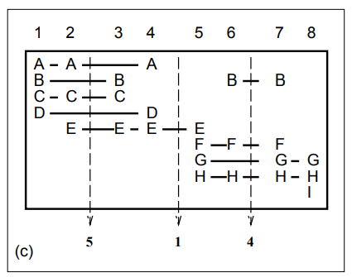
Contd..
Chains – the number of active chains or terms that repeat within threshold and span the sentence gap

Slide 30
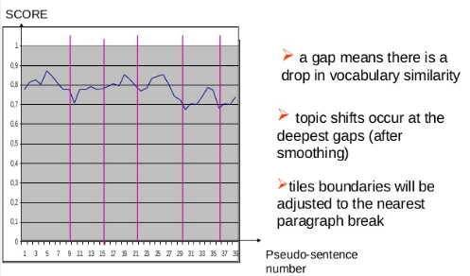
Contd..

Slide 31
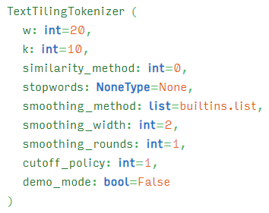

Slide 32
Topic modelling

Slide 33
Example – Topic modelling
It is a type of statistical modeling for discovering the abstract “topics” that occur in a collection of documents
LDA/LSI can be used to classify text in a document for particular topic
LDA builds a topic per document model and word per topic model, modelled as Dirichlet distribution

Slide 34
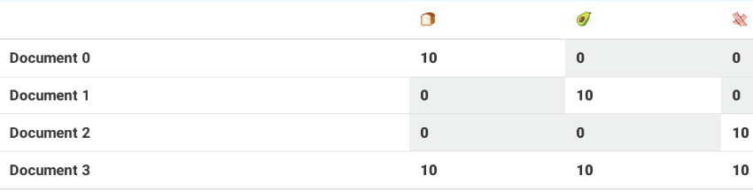
LDA
It is a generative probabilistic model
Its most common use in NLP is in topic modelling
It is a collection of composites made up of parts
In topic modelling composites are documents and parts are words/phrases
LDA consists of two table
First table describes probability of selecting a particular part when sampling a particular topic
Second table describes the chance of selecting a particular topic when sampling a particular document

Slide 35
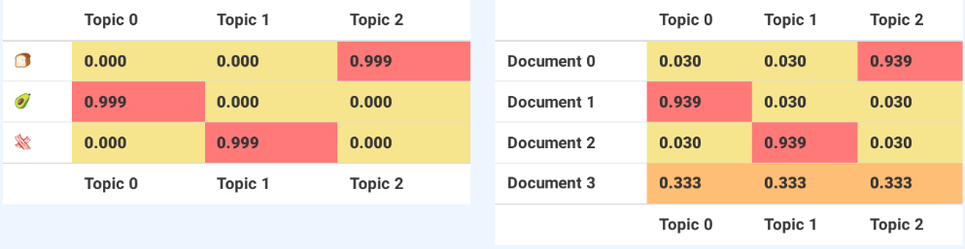
Contd..
The left table shows emoji versus topic and the right shows document vs topic
Each column in the left table and each row in the right table sums to one

Slide 36
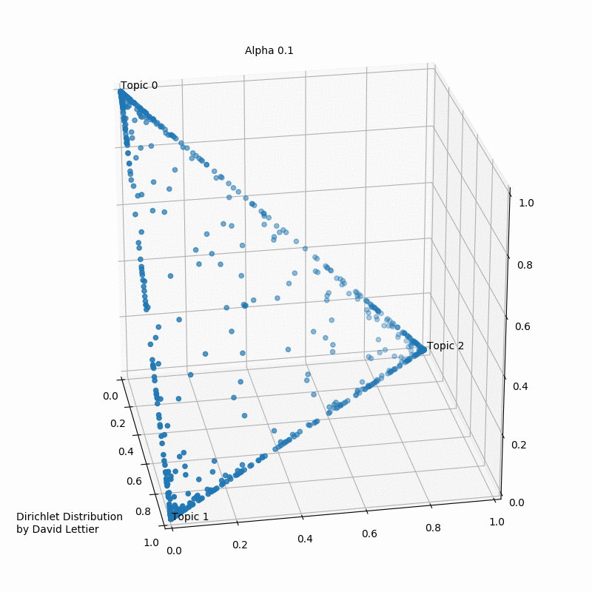
Dirichlet distribution
Parameters alpha (for above we used same for all topic)
Each dot represent a mixture of three topics – 1 0 0 means document has 1 topic
For a low alpha value we will end up lot of samples in the corners (one topic)
For alpha greater than 1 samples tend to be in the center of the triangle – i.e. uniform samples
Beta hyperparameters controls the distribution of words per topic
Ideally we would like to have alpha and beta bit less than 1

Slide 37
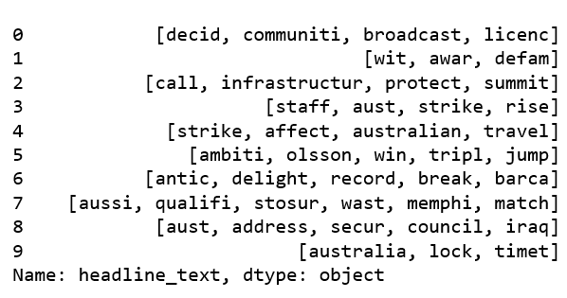
Contd..
Lets say after pre-processing our data looks like

Slide 38
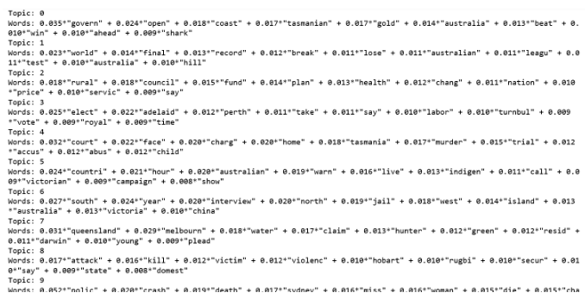
Contd..

Slide 39
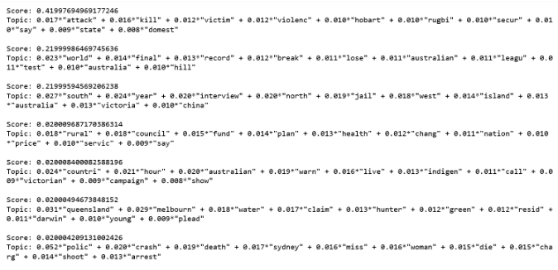
Contd..
Lets say for a test document after preprocessing we get train, help, dampen, bushfir

Slide 40
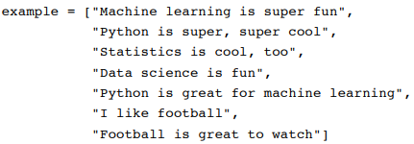
LSA example

Slide 41
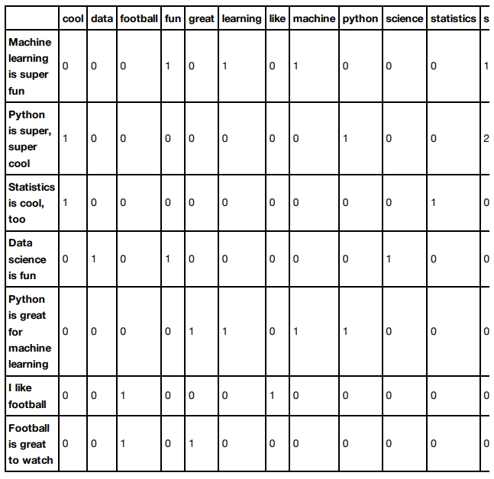
Contd..
Term document matrix – each document is a 13 dimensional vector
Each entry equals the number of times the word appears in the doc

Slide 42
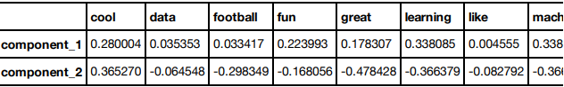
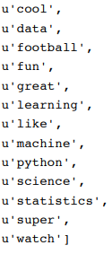
Contd..
Now we do SVD
Each LSA component is a linear combination of words

Slide 43
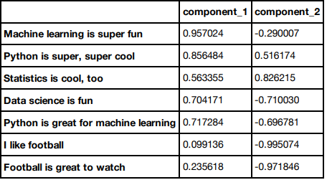
Contd..
Each document is a linear combination of LSA components

Slide 44
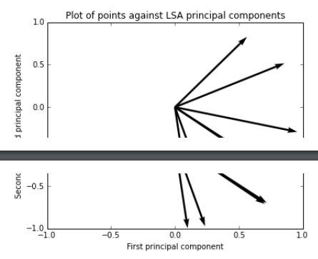
Contd..

Slide 45
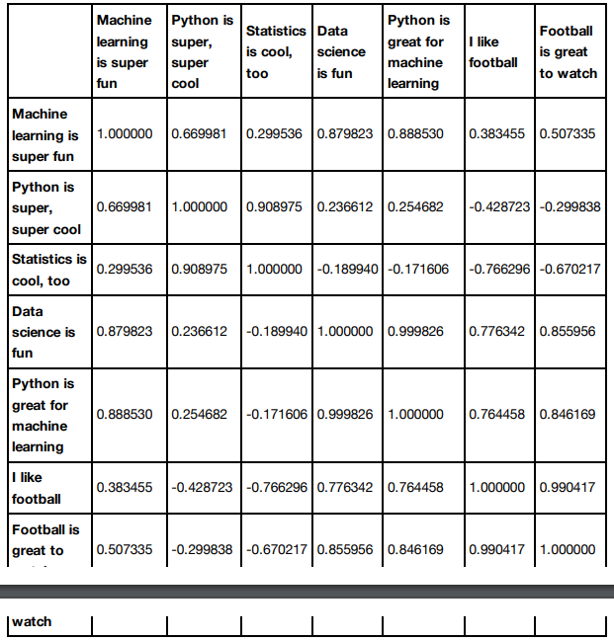
Contd..
Document similarity using LSA

Slide 46
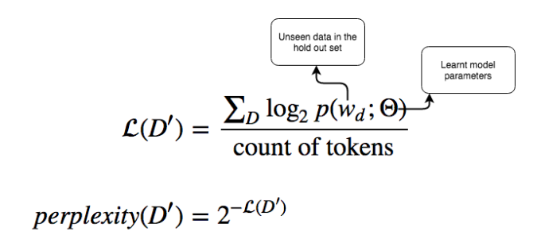
Evaluation of topic modelling
There are two important techniques to evaluate
Perplexity
Topic coherence
Perplexity
Given a trained model, perplexity measures how the model is surprised when it is given a new dataset
This is measured as a log0likelihood of the held out test set
The lowest the perplexity, better the model

Slide 47
Vectorization

Slide 48
What is vectorization of text
Converting text into meaningful vector of numbers for mathematical computation purpose
One hot encoding
Uses a vector with Boolean elements – 1 representing the word exists and 0 representing does not exist
Why normalizing tokens is important in this approach
Bag of Words –
a fixed length of vector where each entry corresponds to a word in pre-defined dictionary of words
Size of the vector equals the size of the dictionary
Each element of the vector s normally based on the count operation
E.g. {NLP, Learn, is, not, that, the, great} for this dictionary there are 4 words only in the corpus and this is the sequence
For the sentence NLP learning is great vector representation can be {1, 1, 1, 0, 0, 1}
Hashing Vectorizer
Applies a hashing function to term frequency counts in each documents
Depending of the use case of the word vectors, it is possible to reuse the length of the hash feature vector
Default number of hash feature is (2^20)
If the matrix size is wider than vocabulary, it will make the matrix very sparse
Representation can be improved using techniques such as
Removing stop words, lemmatizing words
Using n grams or tf-idf instead of counts

Slide 49
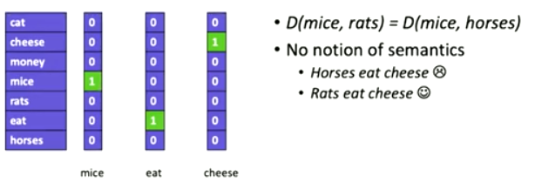
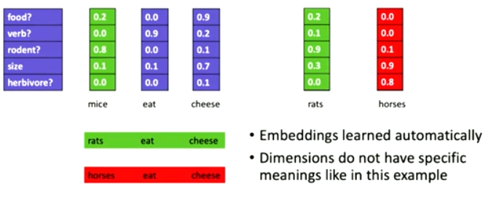
Word representation – one hot
One hot representation
Word embedding enable semantics

Slide 50
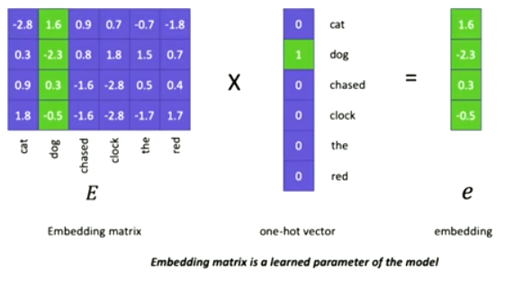
From one hot to word embedding

Slide 51
Documents as vectors
We have a |V| dimensional vector space
Terms are axes of the space
Documents are points or vectors in this space
Very high dimensional tens of million of dimensions when applied to a web earch engine
These are very spare vectors – most entries are zero

Slide 52
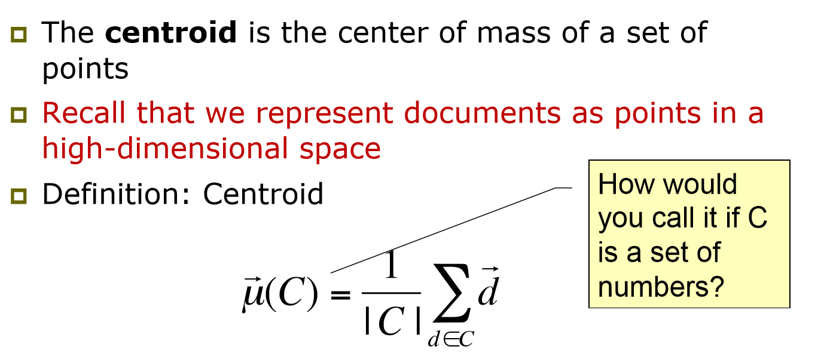
Key concept - Centroid

Slide 53

Contd..

Slide 54

Theoretically best query

Slide 55


Similarity measures
Item A has the largest norm, and is ranked higher according to the dot-product. Item C has the smallest angle with the query, and is thus ranked first according to the cosine similarity. Item B is physically closest to the query so Euclidean distance favors it.

Slide 56

Similarity measure : Cosine

Slide 57

Similarity measure : Euclidian

Slide 58


Motivation
In a typical document classification task the input to the machine learning algorithm is free text
A typical vectorization can adopt bag of words in which individual tokens are extracted and counted
Each distinct token in the training set defines a feature
John likes to watch movies, Mary likes movies too, John also likes football can be converted using the dictionary
The problem with this approach is such dictionaries take up a large amount of storage space
If the vocabulary is kept fixed and not increased with a growing training set, an adversary may try to invent new words or misspelling that are not in the stored dictionary to circumvent a machine learning filter
This is why feature hashing was invented (yahoo spam filtering)

Slide 59
TF-IDF
Keywords are descriptive words or phrases that characterize a document.
It is an abbreviation for term frequency – Inverse document frequency
It is used to transform text into meaningful representation of numbers
This technique is used across various NLP applications to extract features
Other popular vector representations are word co-occurrence matrix, word2vec and GloVe
It is also a type of occurrence based numeric representation of text
Term frequency : it is defined as the normalize the occurrence of word
tf(w) = doc.count(w)/total words in doc
Inverse frequency : for very common words term frequency does not mean much. E.g. “the’, ‘a’ etc
Inverse frequency discounts this by a factor
idf(w) = log(total number of documents/number of documents containing word w)
TF-IDF representation gives high value for a given term if that term occurs in that particular document and very rarely anywhere
Tf-idf(w) = tf(w)*idf(w)
A high score suggests a more meaningful word in a document

Slide 60
Contd..
Scikit-earn provides two methods to get a tf-idf weight matrix
The first is a two-part process of using the CountVectorizer class
To count how many times each term shows up in each document
Folllowed by TfidfTransformer class generating the weight matrix
Others does both steps in a single TfidfVectorizer class
CountVectorizer
min_df – sets the minimum number of documents that any term is contained in
max_df – maximum number of documents any term can be found
ngram_range – ta tuple containing the range of ngram sizes to use. (1,3) means to use unigram, bigram and trigram

Slide 61


Contd..

Slide 62
Tf-idf in python
Let’s take an example of a corpus consisting of following 5 documents:
This car got the excellence award
Good car gives good mileage
This car is very expensive
This company is financially good
The company is growing with very high production
The first three documents talk about cars and the remaining two about a company
In the first category, though the car defines the context but significant meaning of each document comes from the attributes related to the car
Similarly, in the other category, the financial and production status of the company would be more useful features.
The rest of the common words, however, are less meaningful and therefore should get a low score.
TF-IDF vectors can be generated at different levels of input tokens (words, characters, n grams)

Slide 63


Slide 64


Contd..

Slide 65
Sentiment analysis

Slide 66
What is sentiment analysis
Using NLP, statistics or machine learning methods to extract, identify or otherwise characterize the sentiment content of a text unit
Sometimes referred to as opinion mining, although the emphasis in this case is on extraction
There are many possibilities for what we might want to classify – users, texts, sentences, predetermined descriptive phrases, words, tweets
There seems to be some relation between positive words and positive reviews
Heuristic/references
General Inquirer
Content analysis tool
Database of words and manually created semantic and cognitive categories, including positive and negative connotations
Used to generate count of words in categories
LIWC
Linguistic inquiry and word count
Similar to GI
Counts words belonging to categories, including positive and negative
Wordnet
A lexical database for English words with emphasis on synonymy
Nouns, verbs, adjectives are grouped into synonym sets
Words are linked according to lexical and conceptual relations (creating a net)
Not specifically sentiment oriented, but has been used to help derive sentiment related information

Slide 67
Contd..
A lexical resource for opinion mining
Based on Wordnet synsets
Each synset is assigned three sentiment scores : positivity, negativity and objectivity
Available Corpora
Movie reviews: IMDB reviews dataset on Kraggle
Sentiwordnet – mapping wordnet senses to a polarity model
Twitter airline sentiment on Kraggle
First GOP debate Twitter sentiment
Amazon fine foods reviews
NLTK has some neat built in utilities for doing sentiment analysis
NLTK sentimentAnalyzer
NLTK VADER sentiment intensity analyzer
Valence aware dictionary and sentiment reasoner sentiment analyzer
It’s a lexicon and rule based sentient analysis tool specifically created for working with social media texts

